Slide 1
Kenyan Consumer Analysis
Presented by: Jordan Gamba
Last Updated December 8th 2024

Slide 2
Table of Contents
Kenyan Consumer Analysis
Objective(What are we talking about?)
Data Story
Conclusion
Appendix

Slide 3
Objective
Analyze market price data from KAMIS on the following products:
- Dry Maize
- W h i t e I r i s h P o t a t o e s
- D r y O n i o n s
- W a t e r m e l o n s
- R i p e a n d U n r i p e ( C o o k i n g ) B a n a n a s
- O r a n g e s
- M a n g o e s
- K a l e s
- R e g u l a r S p i n a c h .
Filter for Nairobi, Kirinyaga, Nyandarua, Meru, Nakuru

Slide 4
Key Questions to answer
- What are the seasonal(quarterly) and monthly trends?
- What are the best and worst times to sell these commodities in each county?
- Which are the top 3 prized markets in each county?

Slide 5
STEPS I USED IN TIME SERIES ANALYSIS
In order to analyze the seasonal or monthly trends of commodities. I used time series analysis. I picked retail price as a factor to analyze over the course of 3 years.
- I analyze the outliers by plotting the retail prices in a box plot
- I detected and removed the retail prices
- I then grouped the data and plotted the retail prices over each product in every county over the course of 3 years
Notes:
Y tre

Slide 6
Why RETAIL PRICE?
All the factors that in the dataset are affected by supply and demand forces in the market apart from date.
All factors such as supply volume, retail prices, whole sale prices will likely adjust when supply or demand increases depending on the season.
- There is a strong co-relation between supply volume, retail prices, wholesale prices to the seasonality thus any factor can be used to calculate seasonality in the market
- Thus it would depend on the data analyst to choose a particular factor to use to analyze
Notes:
Y tre

Slide 7
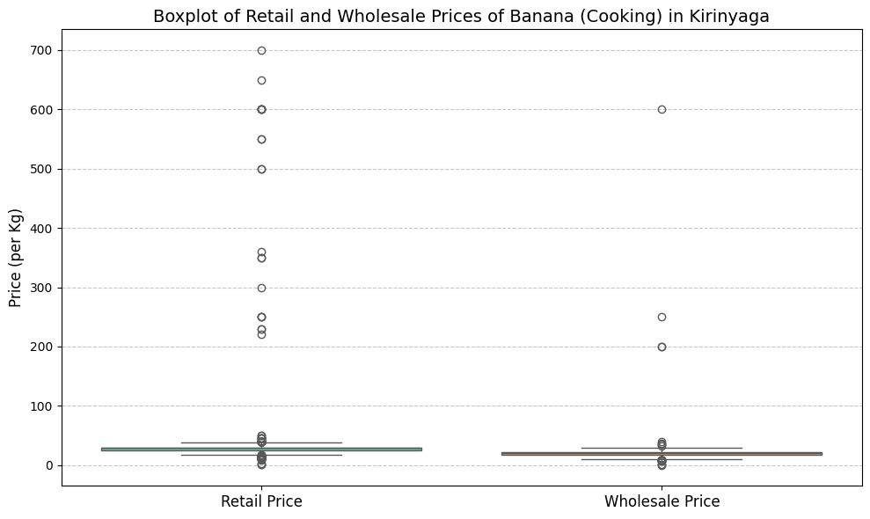
Notes:
Box plot with ouliers

Slide 8
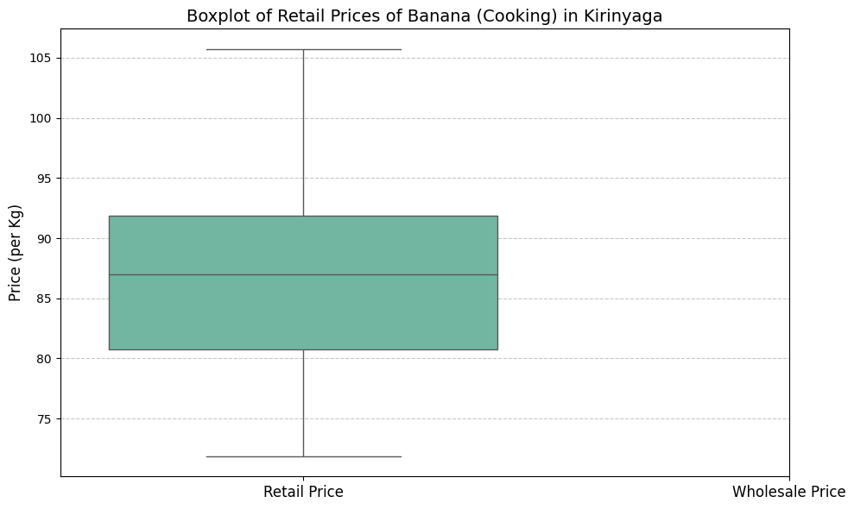
Notes:
Box plot without outliers

Slide 9
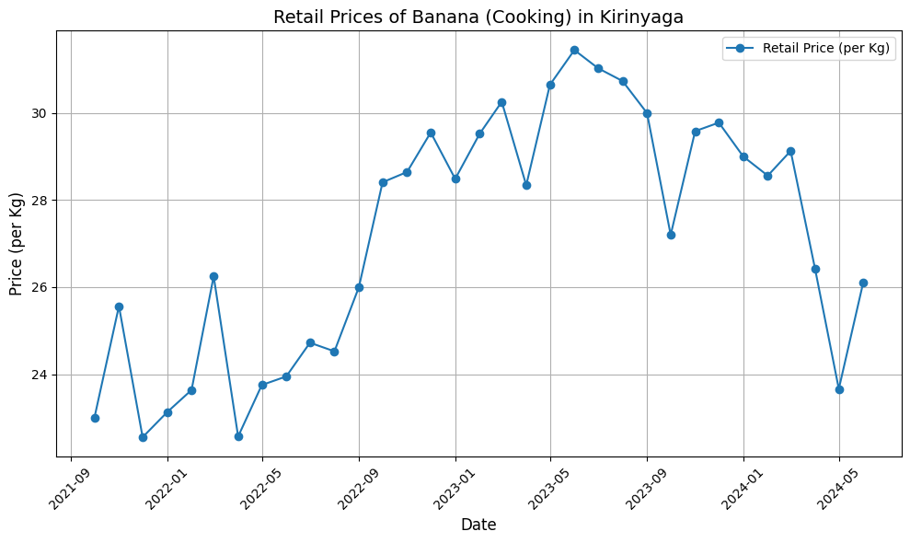
Notes:
The example above is an example of a visualization of Banana(Cooking) retail prices in Kirinyaga county over 3 yrs.

Slide 10
BEST TIME TO SELL

Slide 11
 | Nairobi | Nyandarua | Nakuru | Meru | Kirinyaga
Dry Maize | May-Sep | Jul-Sep | Oct-Dec | Jan-March | May-Sep
W h i t e I r i s h P o t a t o e s | May-Sep | Jan-Apr | Mar-Apr | Nov-Jan | Sep-Jan
D r y O n i o n s | Jan-May | Apr-June | Oct-Dec | Dec-Feb | Jan - May
W a t e r m e l o n s | Sep-Nov | Jul-Aug | May-Aug | Feb-Mar | April/May and Sep
R i p e Bananas | There is no clear trend | May-June | Jan-Feb | Nov | April/May And Sep/Oct
Unripe Bananas | There is no clear trend | May-Sep | Apr-May | Sep-Nov | May-Sep
O r a n g e s | Sep-Oct | Sep-Oct | Sep-Oct | Feb-Mar and July-Aug | May-Sep
Mangoes | Sep-Oct | Mar-May | Apr-June | Mar-April & Jan-Feb | April-July
Kales | There is no clear trend | Price stagnant | Jan-Feb | Jan-Feb and Mar-April | Dec-Jan
Spinach |  | May-Sep | Sep-Oct | Jan-Mar | Sep-Nov
Notes:
Any reoccurrence that occurs twice within 3 yrs. I recorded it as a pattern

Slide 12
WORST TIME TO SELL

Slide 13
 | Nairobi | Nyandarua | Nakuru | Meru | Kirinyaga
Dry Maize | Sep-Dec | No clear trend | Mar-Apr | Jul-Sep | No clear trend
Bananas Cooking | No clear trend | No clear trend | Jan-Feb | Apr-June | Jan-May
White Irish Potatoes | Jan-Apr | No clear trend | Apr-May, Dec-Jan | June-Aug | May-Sep
Dry Onions | Sep-Dec | Jul-Aug | June-July, Apr-May | Apr-June | Sep-Jan
Water Melons | Mar-May | May-June | April-May, Sep-Oct | May-June & Dec | Jan-Feb
Mangoes | May-June | Sep | Apr-May | No trend | Jul-Oct
Ripe Bananas | No clear trend | No clear trend | Feb-Apr, Sep-Oct | No trend | Jan-Feb & Jul-Aug
Kales | No clear trend | Stagnant | Apr-May | Jan-Feb & Mar-Apr | June-Aug
Spinach | No clear trend | Jan | May-June | Oct-Dec | Mar-May
Oranges | Jan-Feb | Apr-May |  | May-June | Jan-May
Notes:
No clear trend – means there was no significant pattern over the course of 3 years
Stagnant- price remained constant in 3 years

Slide 14
Top 3 PRIZED MARKETS IN EVERY COUNTY
In this question I assumed we would be looking at the markets that have the highest retail prices over the course of 3 years.
- I isolated the retail prices of every market per county and summed all of the retail prices. In order to find the priciest markets per county over the course of 3 years.
- I believe this is the correct method to use instead of using the mean or average. I believe the summation of all individual commodity as compared to the average price of individual commodity will be better illustrate the markets with the highest prices over the course of 3 years.

Slide 15
Kirinyaga COUNTY
1.Ngurubani Market
2.Kagio
3.Kutus

Slide 16
MERU COUNTY
1. Kangeta
2. Ngubu
3. Gakorome

Slide 17
NAKURU COUNTY
1.Nakuru Wakulima
2. Molo
3. Nakuru Top Market

Slide 18
Nyandarua COUNTY
1. Soko Mpya
2. Ol-Kalou
3. Kasuku

Slide 19
NAIROBI COUNTY
1.Nairobi Wakulima
2.Gikomba Market
3.Kangemi Market

Slide 20
Reasons BEHING PRICE CHANGES
Prices change due to varying factors. However, over the last 3 yrs the following had a significant effect on prices:
Geo political tension – Ukrainian war this led to significant increases on grains such as maize
Inflation – the depreciating value of the shilling reduced purchasing power of imports
Climate change – there was a significant drought in eastern Africa that delayed rains thus causing significant damage on the supply chain of crops

Slide 21
ReCOMMENDATIONS
- I believe the findings of these results maybe skewed in part due to extraordinary circumstances that affected the prices during these 3 years. In part due to covid 19 pandemic that affected supply chains for 2 and half years.
- I believe these findings can’t be accurately be used to predict buyer and seller preferences and a broad 5-year analysis should be used in order to predict the best and worst time for a trader to sell their crops.

Slide 22
CONCLUSION
The seasonality/trend of prices of crops in Kenya mainly depends on rainfall and stability of the shilling versus the dollar.
I noted that the retail prices of commodities tend to decrease coincides with rainfall seasons when the supply of commodities is high and shifts when the weather patterns decrease. This also affects all the factors such as supply volume and also wholesale prices.

